Slide 1
Stemming the spread of rumors in a social network
SocioElite
Akshay Kumar | IIT Kanpur
Khushi Gupta | IIT Guwahati
Shubham Gupta | IIT Kanpur
Balaji Vasan Srinivasan | Adobe Research

Slide 2
Social Media - Lots of upsides!

Slide 3
Provides an excellent platform to share information

Slide 4
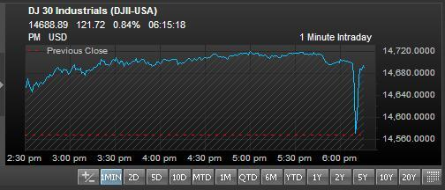
Not all information is positive or reliable

Slide 5
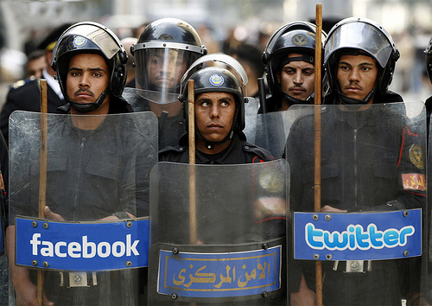
What if ?
The Egyptian Government had a mechanism to limit the spread of the anti-campaign
Could the revolution have been avoided?
Nestle had a way to nullify GreenPeace’s campaign
Could Nestle have saved it’s reputation?

Slide 6
Problem Statement
Given a rumor/negative campaign in a social network, identify nodes critical to its flow and design a mechanism to control the spread.
Objectives:
Given a campaign, identify its potential origin/sources
Determine the effect of the campaign across the nodes
Identify nodes that can potentially stem the flow of the campaign
Design mechanisms to limit the spread of the rumour

Slide 7
Proposed Approach
Compute network edge weights
Identify nodes at key locations as monitors (evangelists)
Estimate campaign spread based on monitors’ status
Extrapolate spread to find susceptible nodes in the network
Identify key influencers to target these nodes with positive information
Part 1: Diffusion modeling
Part 2: Campaign source and spread estimation
Part 3: Seeding and targeting positive campaigns

Slide 8
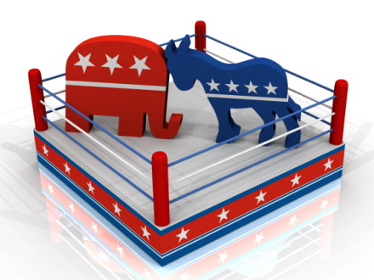
Demo

Slide 9
Proposed Approach
Compute network edge weights
Identify nodes at key locations as monitors (evangelists)
Estimate campaign spread based on monitors’ status
Extrapolate spread to find susceptible nodes in the network
Identify key influencers to target these nodes with positive information
Part 1: Diffusion modeling
Part 2: Campaign source and spread estimation
Part 3: Seeding and targeting positive campaigns

Slide 10
Proposed Approach
Compute network edge weights
Identify nodes at key locations as monitors (evangelists)
Estimate campaign spread based on monitors’ status
Extrapolate spread to find susceptible nodes in the network
Identify key influencers to target these nodes with positive information
Part 1: Diffusion modeling
Part 2: Campaign source and spread estimation
Part 3: Seeding and targeting positive campaigns

Slide 11
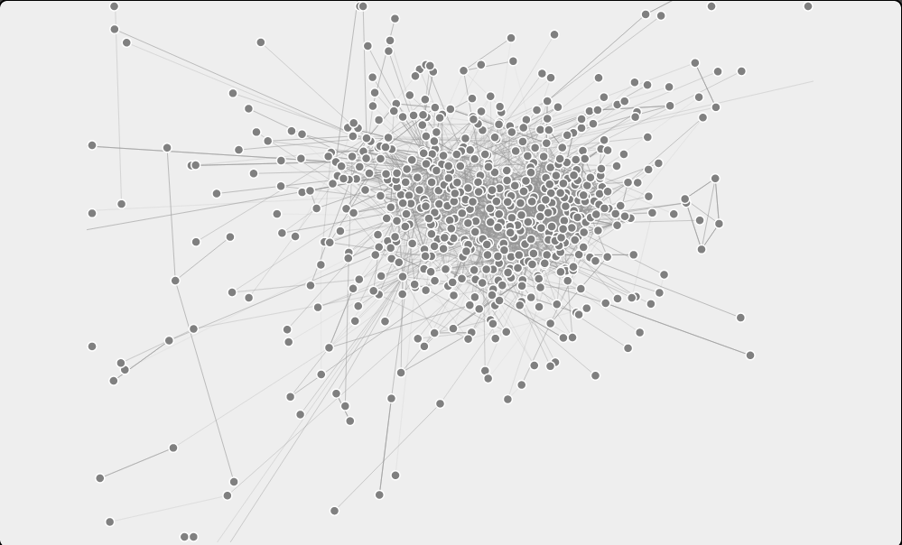
Data Set
Twitter data (from MMI Social Media)
571 nodes
For each node:
Extract interests based on the tweets
Edge-weight
Reflects the interest overlap – based on topic models

Slide 12
Proposed Approach
Compute network edge weights
Identify nodes at key locations as monitors (evangelists)
Estimate campaign spread based on monitors’ status
Extrapolate spread to find susceptible nodes in the network
Identify key influencers to target these nodes with positive information
Part 1: Diffusion modeling
Part 2: Campaign source and spread estimation
Part 3: Seeding and targeting positive campaigns

Slide 13
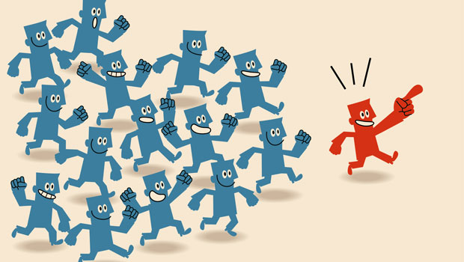
Campaign Source Estimation: Monitor Nodes
Positive Monitors
Monitor Selection
Ping the monitors
Seen the negative campaign
Not seen the negative campaign
Negative Monitors

Slide 14
Source Identification : Approach 1
Given: Graph topology, Positive Monitors, Negative Monitors
All the nodes: potential sources
Potential sources filtered on various factors
Reachability to the Positive Monitors
Distance from the Positive Monitors
Distance from the Negative Monitors
Reachability to the Negative Monitors

Slide 15
Experiment 1: Error in Information Source Detection

Slide 16
Source Identification : Approach 2
Given : Graph G, Positive Monitors, Negative Monitors
Reverse the edges in the graph G
Set1: Set of nodes that can be influenced by Positive Monitors
Set2: set of nodes that can be influenced by Negative Monitors
Potential Source: Set1 not in Set2

Slide 17
Proposed Approach
Compute network edge weights
Identify nodes at key locations as monitors (evangelists)
Estimate campaign spread based on monitors’ status
Extrapolate spread to find susceptible nodes in the network
Identify key influencers to target these nodes with positive information
Part 1: Diffusion modeling
Part 2: Campaign source and spread estimation
Part 3: Seeding and targeting positive campaigns

Slide 18
Measuring “Susceptibility”
Susceptibility
Define a notion of susceptibility of all the nodes
Targets
Identify nodes to target with our positive campaign
Hypothesis: People who are most vulnerable need to be targeted
Drivers
Identify best drivers who can pass the positive information to the targets
Not Infected
Vulnerable
Infected and dead

Slide 19
Susceptibility Score: Approach 1
Susceptibility
Influence
Number of connections to infected nodes
Connectivity to uninfected from infected
Ranked list

Slide 20
Susceptibility Score: Approach 2
Graph Transformation
Shortest Path to Source
Rank based on the path length
A
w
B
pg_{A}
pg_{B}
A₁
B₁
w
pg_{A}
pg_{B}
A₂
B₂

Slide 21
Results and analysis

Slide 22
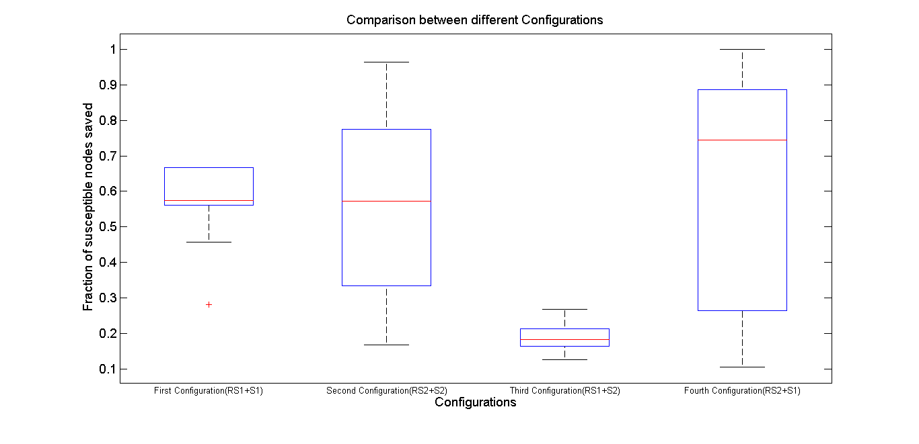
Experiment1: Percentage Susceptible Nodes Saved

Slide 23
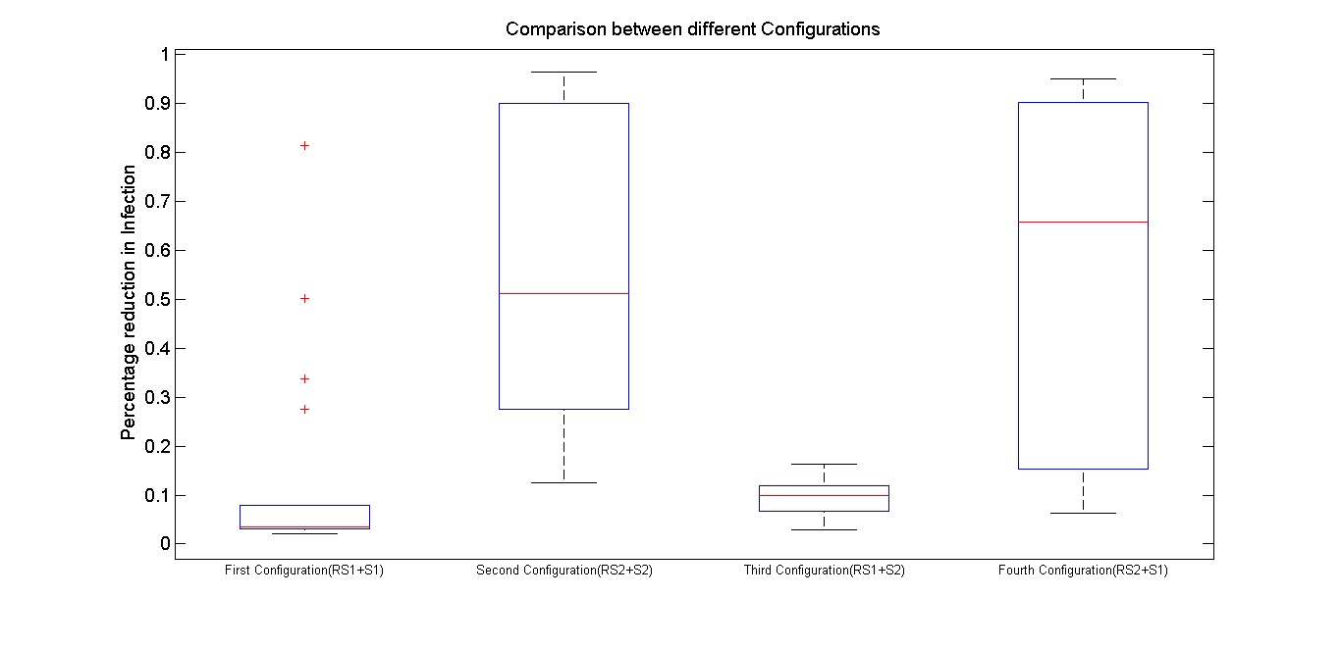
Experiment2: Percentage Infections Avoided

Slide 24
Papers and IDs
Paper
Identify influential seeds in the presence of parallel campaigns, to be submitted to Siam Conference on Data Mining, 2014 (October deadline)
Invention Disclosure
Identifying rumor sources in a social network
Ranking nodes based on their importance to spread the infection

Slide 25
Internship is not all about work!

Slide 26
We were travelling…

Slide 27
We were dancing and partying…

Slide 28
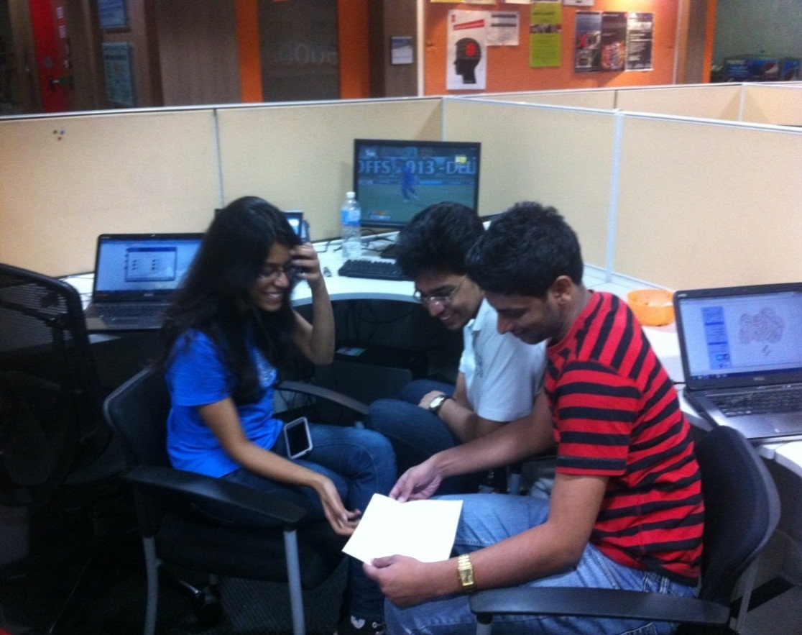
Amidst all these, there was some time for serious work!?!?

